Slide 1

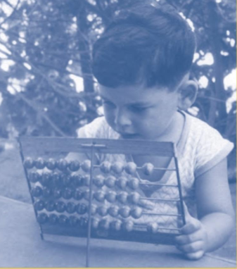
Building a Modern Computer
Efi Arazi School of Computer Science
Introduction to Computer Science
Lecture 13-2
From First Principles

Slide 2

BANG
... 1001010100101101010
0100101001010010101011100110100010100100100100111100100010001111111011010100101101 ...
Bits
Atoms
Neurons
Genes

Slide 3
Hello World
Java / Python
// Prints some numbers
i = 1
while (i < 4) {
print(i);
i = i + 1;
}
...

Slide 4
Hello World
1
2
3
Java / Python
// Prints some numbers
i = 1
while (i < 4) {
print(i);
i = i + 1;
}
...

Slide 5
Hello World
1
2
3
Java / Python
Wow!
How did this happen?
// Prints some numbers
i = 1
while (i < 4) {
print(i);
i = i + 1;
}
...

Slide 6
Hello, World Below
1
2
3
Java / Python
Binary code
// Prints some numbers
i = 1
while (i < 4) {
print(i);
i = i + 1;
}
...
0000000000010000
1110111111001000
0000000000010001
1110101010001000
0000000000010000
1111110000010000
0000000000000000
1111010011010000
0000000000010010
1110001100000001
0000000000010000
1111110000010000
...
compile

Slide 7
Hello, World Below
1
2
3
Java / Python
Binary code
// Prints some numbers
i = 1
while (i < 4) {
print(i);
i = i + 1;
}
...
0000000000010000
1110111111001000
0000000000010001
1110101010001000
0000000000010000
1111110000010000
0000000000000000
1111010011010000
0000000000010010
1110001100000001
0000000000010000
1111110000010000
...
compile
execute
Software issues
Compile?
Execute?
Runtime?
…
Hardware issues
Binary code?
Chips?
Screen?
...
?

Slide 8
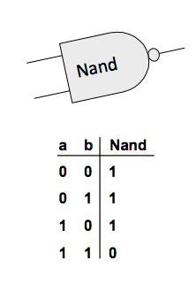

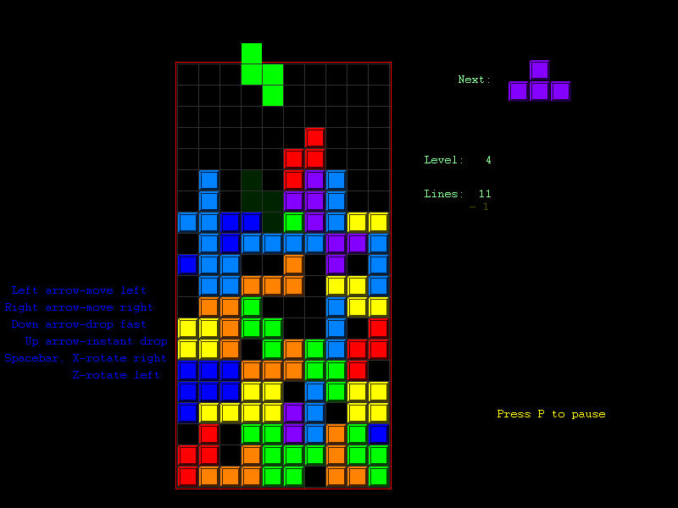

Nand to Tetris
building a modern computer system from first principles
“What I hear I forget,
what I see I remember,
what I do I understand”

Slide 9

Nand to Tetris
hardware platform
software hierarchy
Projects 1-6
Projects 7-12
Using HDL and a hardware simulator
Using Java / Python + supplied specs and test programs

Slide 10

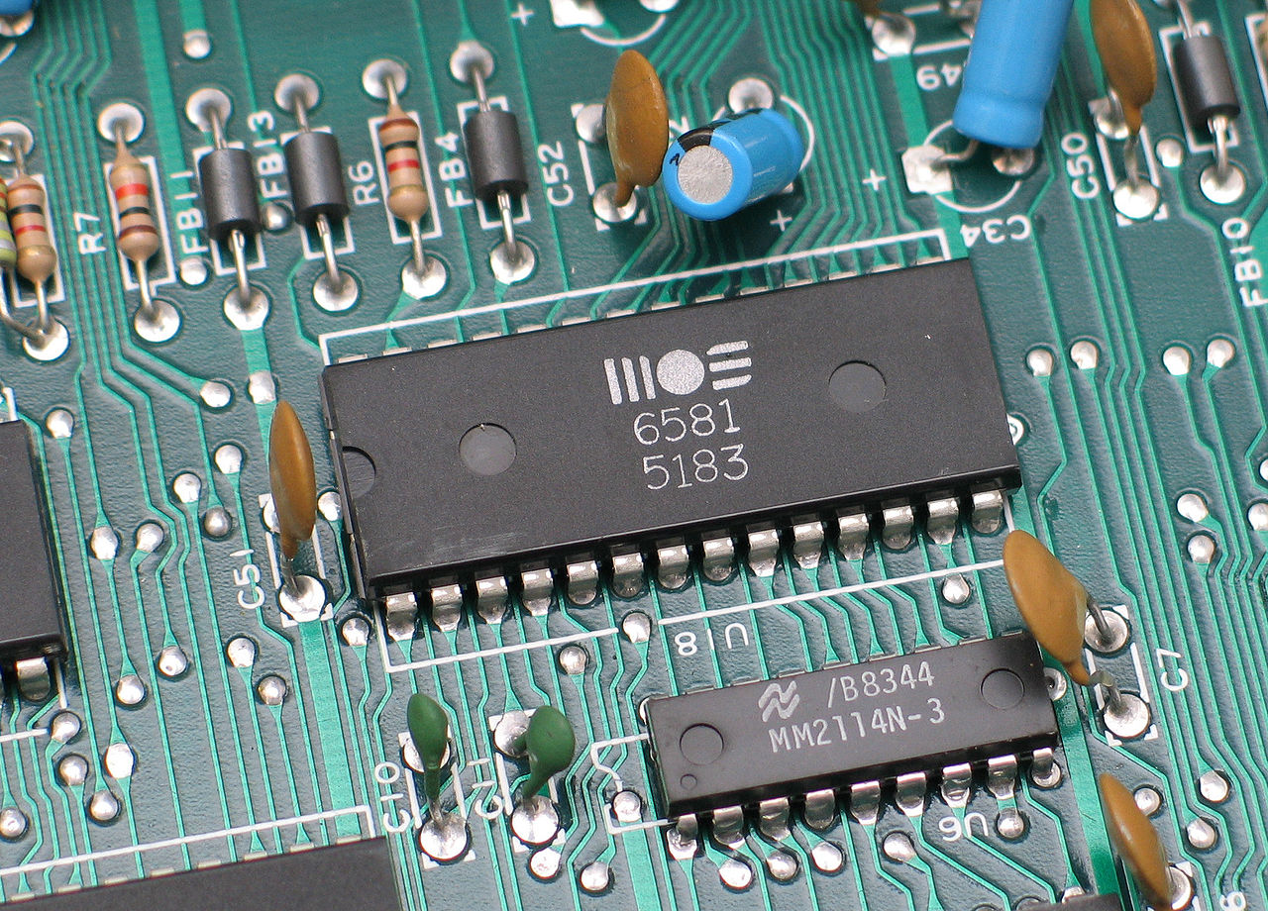
Nand to Tetris
abstract
concept
... 1001010100101101010
0100101001010010101011100110100010100100100100111100100010001111111011010100101101 ...

Slide 11

Nand to Tetris
abstract
concept
Applied
CS
... 1001010100101101010
0100101001010010101011100110100010100100100100111100100010001111111011010100101101 ...

Slide 12
Nand to Tetris
abstract
concept
Nand

Slide 13
Nand to Tetris
software hierarchy
abstract
concept
hardware platform
Nand

Slide 14
Nand to Tetris
software hierarchy
abstract
Writing a
abstraction
concept
program
high-level language
building a
abstraction
compiler
VM code
building a
abstraction
OS
VM
machine language
assembler
abstraction
hardware platform
CPU, Computer
building a
abstraction
computer
ALU, RAM
building
abstraction
chips
elementary logic gates
building
Nand
gates

Slide 15
Nand to Tetris
software hierarchy
abstract
Writing a
abstraction
concept
program
high-level language
building a
abstraction
compiler
VM code
building a
abstraction
OS
VM
machine language
assembler
p6
Part I
Building a general-purpose computer, capable of executing programs in machine language.
p = project,
lecture,
book chapter
abstraction
p4
p5
hardware platform
CPU, Computer
building a
abstraction
p2
p3
computer
ALU, RAM
building
abstraction
p1
chips
elementary logic gates
building
Nand
gates

Slide 16
Nand to Tetris
p9
software hierarchy
abstract
Writing a
abstraction
p10
p11
Part II
Building a software hierarchy, capable of compiling programs written in a high-level language
concept
program
high-level language
building a
abstraction
p6
p7
compiler
VM code
building a
abstraction
OS
VM
machine language
p12
assembler
p6
Part I
Building a general-purpose computer, capable of executing programs in machine language.
p = project,
lecture,
book chapter
abstraction
p4
p5
hardware platform
CPU, Computer
building a
abstraction
p2
p3
computer
ALU, RAM
building
abstraction
p1
chips
elementary logic gates
building
Nand
gates

Slide 17
Part I: Hardware
Given: Nand(a,b)
a b Nand(a,b)
0 0 1
0 1 1
1 0 1
1 1 0

Slide 18
Part I: Hardware
Given: Nand(a,b)
a b Nand(a,b)
0 0 1
0 1 1
1 0 1
1 1 0
Build:
Not(a)
And(a,b)
Or(a,b)
Xor(a,b)
Mux(s,a,b)
...
Adder
ALU
RAM
CPU
Computer
30 chips, leading up to a general-purpose computer platform

Slide 19

Part I: Hardware
Given: Nand(a,b)
a b Nand(a,b)
0 0 1
0 1 1
1 0 1
1 1 0
Not(a) =
And(a,b)
Or(a,b)
Xor(a,b)
Mux(s,a,b)
...
Adder
ALU
RAM
CPU
Computer

Slide 20
Part I: Hardware
Given: Nand(a,b)
a b Nand(a,b)
0 0 1
0 1 1
1 0 1
1 1 0
Not(a) = Nand(a,a)
And(a,b)
Or(a,b)
Xor(a,b)
Mux(s,a,b)
...
Adder
ALU
RAM
CPU
Computer

Slide 21
Part I: Hardware
Given: Nand(a,b)
a b Nand(a,b)
0 0 1
0 1 1
1 0 1
1 1 0
Not(a) = Nand(a,a)
And(a,b) =
Or(a,b)
Xor(a,b)
Mux(s,a,b)
...
Adder
ALU
RAM
CPU
Computer

Slide 22
Part I: Hardware
Given: Nand(a,b)
a b Nand(a,b)
0 0 1
0 1 1
1 0 1
1 1 0
Not(a) = Nand(a,a)
And(a,b) = Not(Nand(a,b()
Or(a,b)
Xor(a,b)
Mux(s,a,b)
...
Adder
ALU
RAM
CPU
Computer

Slide 23
Part I: Hardware
Given: Nand(a,b)
a b Nand(a,b)
0 0 1
0 1 1
1 0 1
1 1 0
Not(a) = Nand(a,a)
And(a,b) = Not(Nand(a,b()
Or(a,b) =
Xor(a,b)
Mux(s,a,b)
...
Adder
ALU
RAM
CPU
Computer

Slide 24
Part I: Hardware
Given: Nand(a,b)
a b Nand(a,b)
0 0 1
0 1 1
1 0 1
1 1 0
Not(a) = Nand(a,a)
And(a,b) = Not(Nand(a,b()
Or(a,b) = Not(And(Not(a),Not(b)))
Xor(a,b)
Mux(s,a,b)
...
Adder
ALU
RAM
CPU
Computer

Slide 25
Part I: Hardware
Given: Nand(a,b)
a b Nand(a,b)
0 0 1
0 1 1
1 0 1
1 1 0
Not(a) = Nand(a,a)
And(a,b) = Not(Nand(a,b()
Or(a,b) = Not(And(Not(a),Not(b)))
Xor(a,b) =
Mux(s,a,b)
...
Adder
ALU
RAM
CPU
Computer

Slide 26
Part I: Hardware
Given: Nand(a,b)
a b Nand(a,b)
0 0 1
0 1 1
1 0 1
1 1 0
Not(a) = Nand(a,a)
And(a,b) = Not(Nand(a,b()
Or(a,b) = Not(And(Not(a),Not(b)))
Xor(a,b) = Or(And(a,Not(b)),And(Not(a),b))
Mux(s,a,b)
...
Adder
ALU
RAM
CPU
Computer
Tools
Chip specifications / test scripts
Hardware Description Language
Hardware simulator.

Slide 27
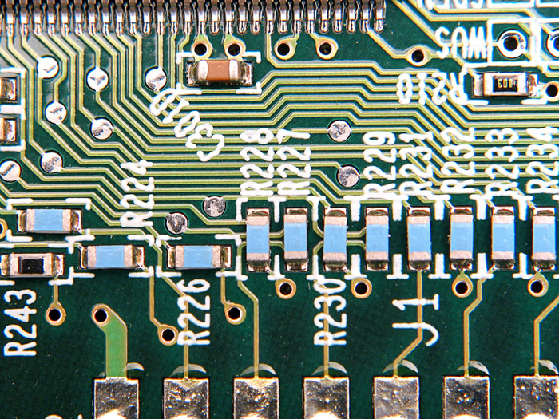
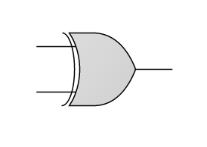
Building a chip
a
?
Xor
out
b
if ((a == 0 and b == 1) or (a == 1 and b == 0))
out = 1
else
out = 0
The process
Design the chip architecture
Specify the architecture in HDL
Test the chip in a hardware simulator
Optimize the design
Realize the optimized design in silicon.

Slide 28
Building a chip
a
?
Xor
out
b
if ((a == 0 and b == 1) or (a == 1 and b == 0))
out = 1
else
out = 0
The process
Design the chip architecture
Specify the architecture in HDL
Test the chip in a hardware simulator
Optimize the design
Realize the optimized design in silicon.

Slide 29
Chip design
a
a | b | out
0 | 0 | 0
0 | 1 | 1
1 | 0 | 1
1 | 1 | 0
Requirement
Build a chip that delivers this functionality
Xor
out
b
if ((a == 0 and b == 1) or (a == 1 and b == 0))
out = 1
else
out = 0
/** out = (a And Not(b)) Or (Not(a) And b)) */
CHIP Xor {
IN a, b;
OUT out;
PARTS:
// Missing implementation
}
/** Chips set (APIs): */
...
Not (in = , out = );
And (a = , b = , out = );
Or (a = , b = , out = );
Xor (a = , b = , out = );
...
HDL program

Slide 30
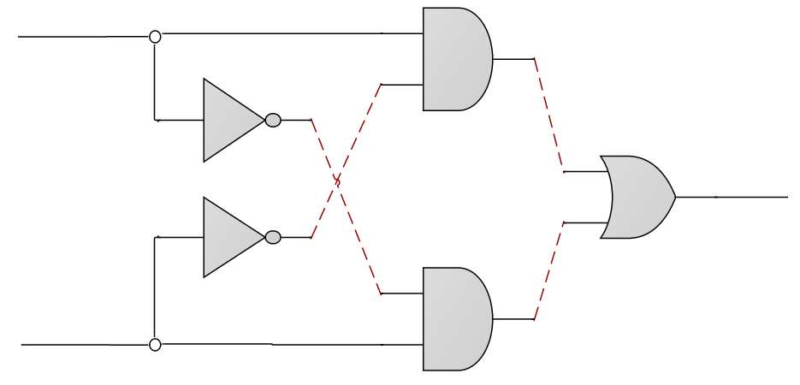
Chip design
a
a
And
out
b
Gate diagram
in
Not
out
aAndNotb
notb
a
Or
out
out
b
in
Not
out
nota
a
notaAndb
And
out
b
b
/** out = (a And Not(b)) Or (Not(a) And b)) */
CHIP Xor {
IN a, b;
OUT out;
PARTS:
// Missing implementation
}
/** Chips set (APIs): */
...
Not (in = , out = );
And (a = , b = , out = );
Or (a = , b = , out = );
Xor (a = , b = , out = );
...
HDL program

Slide 31
Chip design
a
a
And
out
b
Gate diagram
in
Not
out
aAndNotb
notb
a
Or
out
out
b
in
Not
out
nota
a
notaAndb
And
out
b
b
/** out = (a And Not(b)) Or (Not(a) And b)) */
CHIP Xor {
IN a, b;
OUT out;
PARTS:
// Missing implementation
}
/** Chips set (APIs): */
...
Not (in = , out = );
And (a = , b = , out = );
Or (a = , b = , out = );
Xor (a = , b = , out = );
...
HDL program

Slide 32
Chip design
a
a
And
out
b
in
Not
out
aAndNotb
notb
a
Or
out
out
b
in
Not
out
nota
a
notaAndb
And
out
b
b
/** out = (a And Not(b)) Or (Not(a) And b)) */
CHIP Xor {
IN a, b;
OUT out;
PARTS:
// Missing implementation
}
/** Chips set (APIs): */
...
Not (in = , out = );
And (a = , b = , out = );
Or (a = , b = , out = );
Xor (a = , b = , out = );
...
HDL program

Slide 33
Chip design
a
a
And
out
b
in
Not
out
aAndNotb
notb
a
Or
out
out
b
in
Not
out
nota
a
notaAndb
And
out
b
b
/** out = (a And Not(b)) Or (Not(a) And b)) */
CHIP Xor {
IN a, b;
OUT out;
PARTS:
Not (in=a, out=nota);
Not (in=b, out=notb);
And (a=a, b=notb, out=aAndNotb);
And (a=nota, b=b, out=notaAndb);
Or (a=aAndNotb, b=notaAndb, out=out);
}
/** Chips set (APIs): */
...
Not (in = , out = );
And (a = , b = , out = );
Or (a = , b = , out = );
Xor (a = , b = , out = );
...

Slide 34
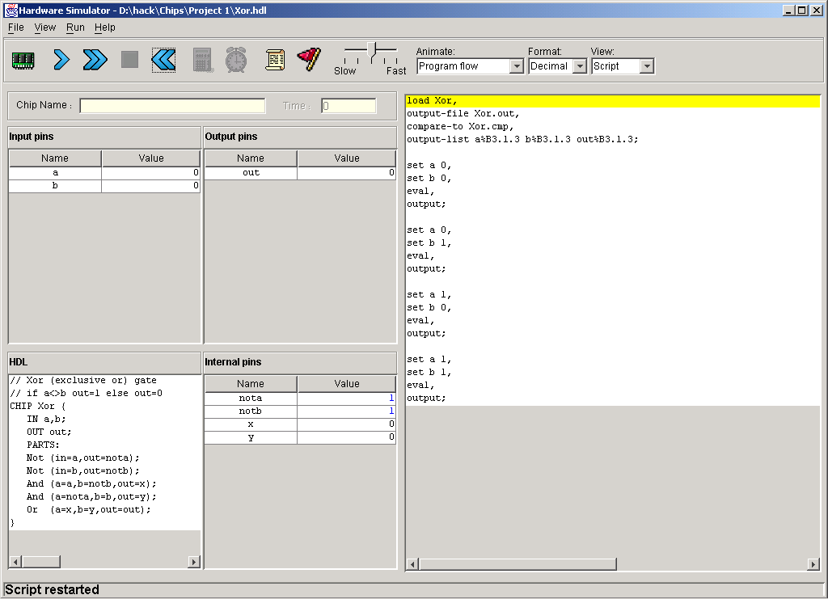
Chip design
a
a
And
out
b
in
Not
out
aAndNotb
notb
a
Or
out
out
b
in
Not
out
nota
a
notaAndb
And
out
b
b
Hardware simulator
/** out = (a And Not(b)) Or (Not(a) And b)) */
CHIP Xor {
IN a, b;
OUT out;
PARTS:
Not (in=a, out=nota);
Not (in=b, out=notb);
And (a=a, b=notb, out=aAndNotb);
And (a=nota, b=b, out=notaAndb);
Or (a=aAndNotb, b=notaAndb, out=out);
}
simulate

Slide 35
Chip simulation
inputs
outputs
test script
HDL code

Slide 36
Chip simulation

Slide 37
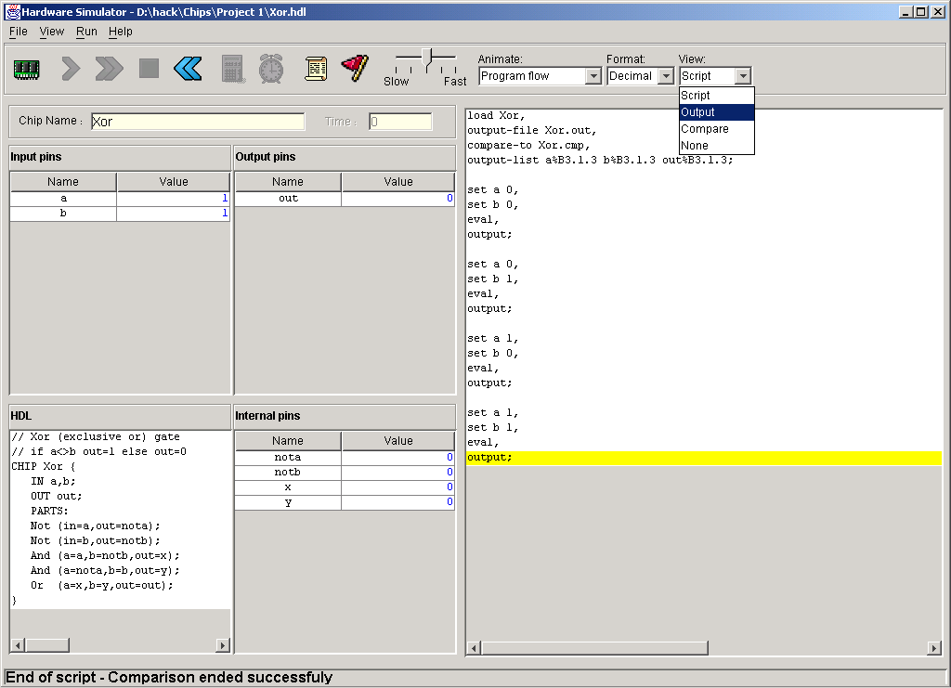
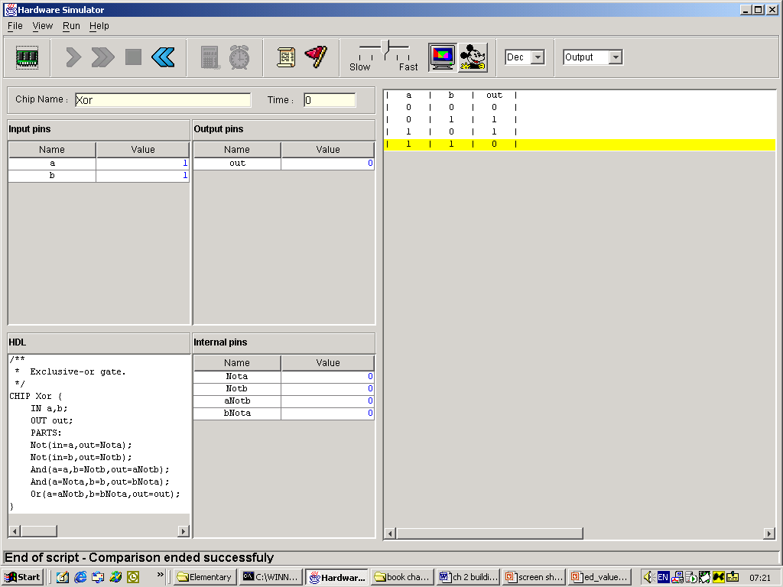
Chip simulation
HDL program
Output

Slide 38
Hardware platform
Given: Nand
Build:
Not
And
Or
Xor
Mux
...
Adder
ALU
RAM
CPU
Computer
Using similar techniques, we build the entire chip-set, leading up to a general-purpose computer system
(Projects 1, 2, 3, 4, 5, 6)

Slide 39
Nand to Tetris: Part I
software hierarchy
abstract
Writing a
abstraction
concept
program
high-level language
building a
abstraction
compiler
VM code
building a
abstraction
OS
JVM
machine language
assembler
p6
abstraction
p4
p5
hardware platform
CPU, Computer
building a
abstraction
p2
p3
p = project,
lecture,
book chapter
computer
ALU, RAM
building
abstraction
p1
chips
elementary logic gates
building
Nand
gates

Slide 40

Nand to Tetris: Part I
software hierarchy
abstract
Writing a
abstraction
concept
program
high-level language
building a
abstraction
compiler
VM code
building a
abstraction
OS
JVM
machine language
assembler
abstraction
hardware platform
CPU, Computer
building a
abstraction
p = project,
lecture,
book chapter
computer
ALU, RAM
building
abstraction
chips
elementary logic gates
building
Nand
gates

Slide 41
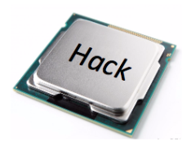
Nand to Tetris: Part II
software hierarchy
abstract
Writing a
abstraction
concept
program
high-level language
building a
abstraction
compiler
VM code
building a
abstraction
OS
JVM
machine language

Slide 42
Nand to Tetris: Part II
p9
software hierarchy
abstract
Writing a
abstraction
p10
p11
concept
program
high-level language
building a
abstraction
p6
p7
compiler
VM code
building a
abstraction
OS
JVM
machine language
p12
Part II:
Building a software infrastructure for compiling programs written in high-level languages (Java, Python, Jack, ...):
Compiler
VM
OS

Slide 43
One-tier compilation example: C
prog.c
prog.out
7 * (4 + 2) / (5 – 3)
1100101001011011
0001010100011001
1000101001000010
1100100001000011
0000101001011000
1000101011011010
0000101001011000
0100101001011010
1100101001011011
1100100001000011
0000101001011000
...
gcc prog.c
Compilation
executable code

Slide 44
Two-tier compilation example: Java
Prog.java
Prog.class
Prog.bin
7 * (4 + 2) / (5 – 3)
push 7
push 4
push 2
add
mult
push 5
push 3
sub
div
1100101001011011
0001010100011001
1000101001000010
1100100001000011
0000101001011000
1000101011011010
0000101001011000
0100101001011010
1100101001011011
1100100001000011
0000101001011000
...
compiler
/
compiler
JVM
*
–
7
+
5
3
4
2
source code
parse tree
(operates on a virtual, stack-based machine)
executable code
javac Prog.java
java Prog
(translates Java code into bytecode)
(translates bytecode into binary code, and executes it)

Slide 45

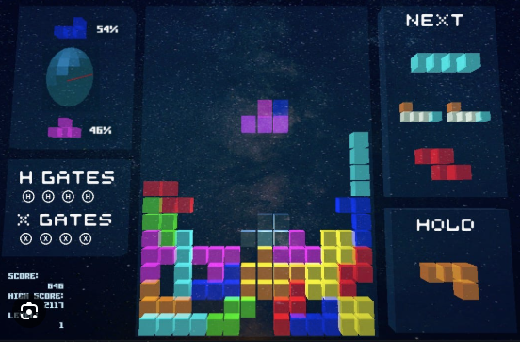

Compilation: Nand to Tetris
source code
intermediate code
assembly code
binary code
Tetris.jack
Tetris.vm
...
M=D
@i
M=0
(LOOP)
@i
D=M
@n
D=D-M
@END
D;JGT
@addr
...
...
1101010010101011
1100001101010101
0101010011101100
1100101111111111
0101110101010011
1100111111010101
0101110110101011
1100100000001011
0101110111100010
1111000111010100
0010101000101011
0111000111010111
1010101000101011
...
class Tetris
function void play {
var Brick b;
...
}
}
...
push local 1
push const 3
add
...
compiler
JVM
assembler
Brick.jack
Brick.vm
class Brick
field int x,y;
...
}
...
push arg 2
call Screen.clr
...
...
push arg 2
call Screen.clr
...
load
(bytecode)

Slide 46
Nand to Tetris Roadmap: Part II
p9
software hierarchy
abstract
Writing a
abstraction
p10
p11
concept
program
high-level language
Building a
abstraction
p7
p8
compiler
VM code
Building a
abstraction
OS
JVM
machine language
p12
Part II Projects
assembler
7, 8: building a JVM
9: writing a some Jack programs
10, 11: building the compiler
12: building an operating system.

Slide 47
Take home lessons
Nand to Tetris
Hardware: Logic gates, Boolean arithmetic, multiplexors, flip-flops, registers, RAM units, counters, Hardware Description Language, chip simulation and testing.
Architecture: ALU/CPU design and implementation, addressing modes, memory-mapped I/O, machine code, assembly language programming,
Programming Languages: Object-based design and programming, abstract data types, scoping rules, syntax and semantics, references.
Compilation: Lexical analysis, top-down parsing, symbol tables, pushdown automata, virtual machine, code generation, implementation of arrays and objects.
Data structures and algorithms: Stacks, trees, hash tables, lists, recursion, arithmetic algorithms, geometric algorithms, time / space complexity
Engineering: Abstraction / implementation, modular design, API design and documentation, unit testing, quality assurance, programming at the large.

